Slide 1
Digital Portfolio
STUDENT NAME: VIGNESH.P
REGISTER NO :20324U09100
NMID: A373B9541E20F1ABC4C4624E2813BCA7
DEPARTMENT: BCA
COLLEGE: Dr. M.G.R. CHOCKALINGAM ARTS COLLEGE,ARNI
UNIVERSITY:THIRUVALLUVAR UNIVERSITY

Slide 2
PROJECT TITTLE
MY DIGITAL PORTFOLIO
(HTML,CSS & JAVASCRIPT)

Slide 3


AGENDA
Problem Statement
Project Overview
End Users
Tools and Technologies
Portfolio design and Layout
Features and Functionality
Results and Screenshots
3/21/2024 Annual Review

Slide 4

PROBLEM STATEMENT
In today's digital age, students often struggle to effectively showcase their academic achievements, skills, projects, and extracurricular activities in a centralized, accessible, and visually appealing format. Traditional methods such as printed resumes or scattered online documents fail to present a cohesive and dynamic representation of a student's abilities and growth over time.

Slide 5

PROJECT OVERVIEW
In the digital era, a personal portfolio is an essential tool for students to demonstrate their capabilities beyond a traditional resume. This project will create a responsive and interactive web application using HTML, CSS, and JavaScript (optionally including frameworks like React or Bootstrap) to help students:
Create a personal online identity.
Display educational qualifications and certificates.
Showcase academic and personal projects.
Highlight technical and soft skills.
Provide downloadable resumes and external links (e.g., LinkedIn,GitHub).

Slide 6

WHO ARE THE END USERS
End User | Role | Purpose
Students | Creators and owners | Build and maintain their own portfolio
Teachers/Mentors | Reviewers and guides | Evaluate and support student progress
Employers/Recruiters | Potential hirers | Discover and assess talent
Admissions Officers | Evaluators for academic programs | Review detailed student profiles
General Public/Peers | Visitors or collaborators | Explore, learn, and connect

Slide 7

TOOLS AND TECHNIQUES
Dark/Light Mode Toggle – Using JavaScript and CSS variables.
Animations & Transitions – Using CSS or libraries like AOS (Animate on Scroll).
Form Handling – Using JavaScript or integrating with services like Forms pree for contact forms.
Progressive Web App (PWA) – Making the portfolio installable and offline-accessible (advanced).

Slide 8
POTFOLIO DESIGN AND LAYOUT
Sections included:
Home/About Me
Projects
Skills
Contact
Responsive Layout (mobile + desktop view)
8

Slide 9
FEATURES AND FUNCTIONALITY
Navigation bar with smooth scrolling
Project showcase with images/details
Contact form(with validation)
Responsive design for all devices.

Slide 10
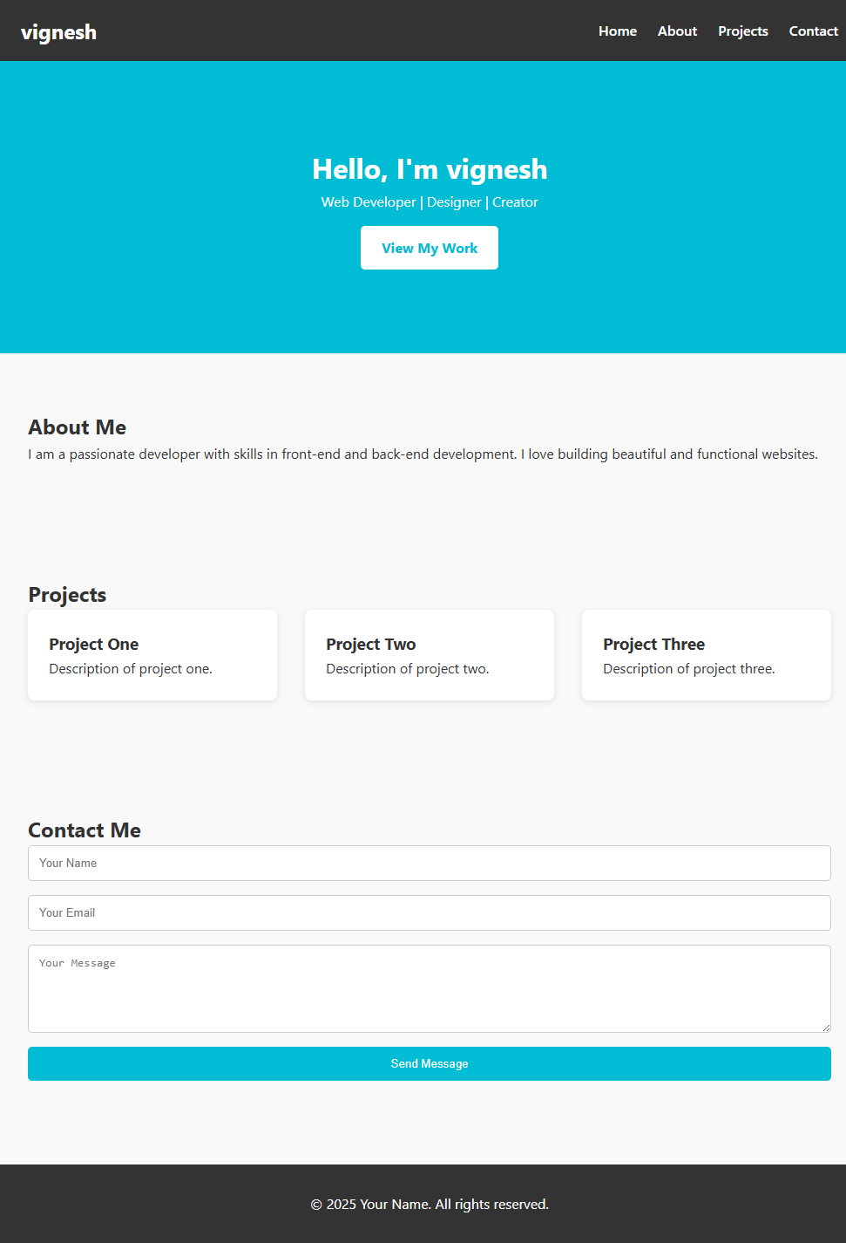
RESULTS AND SCREENSHOTS
Screenshots of each section
Before Vs After (plain HTML with CSS & JS
3/21/2024 Annual Review
10

Slide 11
CONCLUSION
📌 Conclusion: Digital Portfolio Project
The Digital Portfolio project serves as a comprehensive and interactive platform to showcase personal skills, achievements, and projects in a professional format. By leveraging core web technologies — HTML, CSS, and JavaScript — the portfolio not only presents content effectively but also demonstrates technical proficiency in web development.
Through this project, I gained hands-on experience in:
Structuring a responsive web page using semantic HTML
Styling with modern CSS techniques (Flexbox, Grid, responsive design)
Adding interactivity with JavaScript (form handling, smooth scrolling, etc.)
In addition to technical skills, this portfolio highlights my personal brand and creates a central online presence that can be shared with potential employers, clients, or collaborators. It reflects both creative and development capabilities while offering room for future improvements like adding:
Project galleries
Blog posts
Dark mode or accessibility features
Backend integration (e.g., contact form submission)
Ultimately, this portfolio is not just a project — it's a living, evolving representation of my growth as a developer and creator.
11

